Slide 1
Pricing at Vocram Airways
Dalya Mirlas

Slide 2
The Problem Statement
In this case study, Vocram Airways is trying to determine the optimal flight price to maximize expected revenue per flight while serving publicly funded (40%) and private (60%) clients with different uniformly distributed willingness-to-pay (between $0–$100 and $0–$150, respectively). Since the plane has only three seats, the challenge is balancing pricing and demand without knowing a caller's client type in advance.

Slide 3
Our Assumptions
The distance covered for each of the flights does not impact the pricing.
Government and private clients will be quoted the same price since O’Rory can’t differentiate them in a call.
The number of calls per flight is 10.
The revenue only depends on the price charged per flight to customers and any additional cost such as maintenance costs are considered negligible.
Customers cannot cancel a booking. Bookings can only increase or stay the same after a phone call.
The highest possible price is $100. If the maximum price is $150, the transition probability matrix will have negative probabilities due to government clients having a “negative” willingness to pay more than $100. Since negative probabilities is an absurd concept, we are avoiding prices greater than $100 altogether.

Slide 4
The Developed Model – Data
Lists:
states = [[0,0],[1,0],[2,0],[3,0],[0,1],[1,1],[2,1],[0,2],[1,2],[0,3]] → These are states of the Markov Chain taken from exhibit 1. It is referenced by [state index][Group index]. Group 1 is government and group 2 is private.
Constants:
ub_gov = 100 → The price upper bound for a government customer
ub_private = 150 → The price upper bound for a private customer
prop_gov = 0.4 → Proportion of government customers
prop_private = 0.6 → Proportion of private customers

Slide 5
Deriving the Willingness to Pay (Introduction)
Government willingness is uniformly distributed between $0 and $100.
Gov customers accept a $0 price with probability 1 and accept a $100 price with probability 0.
Private willingness is uniformly distributed between $0 and $150.
Private customers accept a $0 price with probability 1 and accept a $150 price with probability 0.
Need to find the 𝑦=𝑚𝑥+𝑏 equations
For both lines 𝑏 = 1.

Slide 6

Deriving the Willingness to Pay (Government)
Equation of government willingness:
$$0=m∗100+1$$
$$m=−\frac{1}{100}$$
$$y=−\frac{1}{100}x+1$$
ub_gov = 100 in constants section as defined in slide 2.
Therefore, government willingness is:
$$\boxed{go{v_willingness}_{price}=1−\frac{price}{ub_gov}}$$

Slide 7

Deriving the Willingness to Pay (Private)
Equation of private willingness:
$$0=m∗150+1$$
$$m=−\frac{1}{150}$$
$$y=−\frac{1}{150}x+1$$
ub_private = 150 in constants section as defined in slide 2.
Therefore, private willingness is:
$$\boxed{go{v_willingness}_{price}=1−\frac{price}{ub_private}}$$

Slide 8
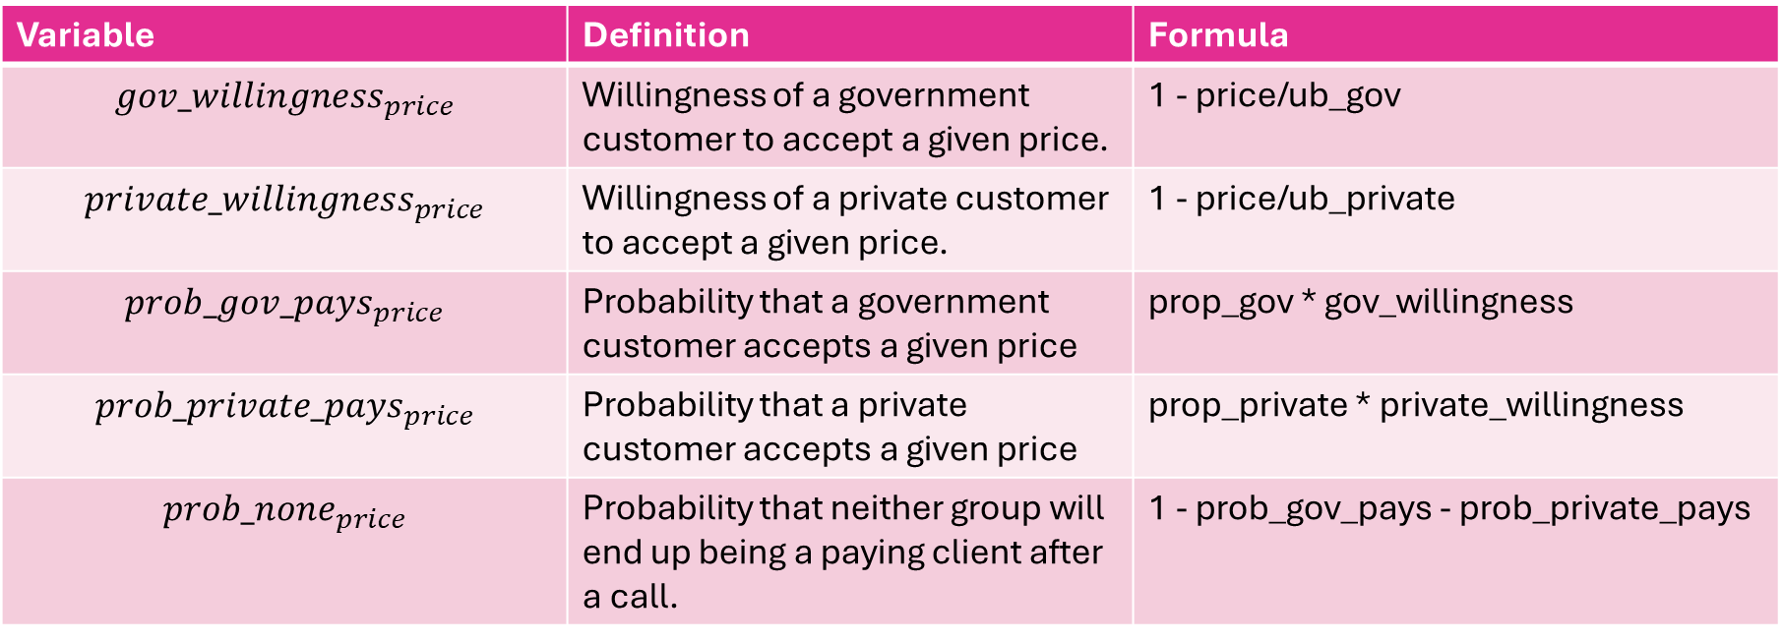
The Developed Model – Variables
Variable | Definition | Formula
$$gov_willingness_{price}$$ | Willingness of a government customer to accept a given price. | 1 - price/ub_gov
$$private_willingness_{price}$$ | Willingness of a private customer to accept a given price. | 1 - price/ub_private
$$prob_gov_pays_{price}$$ | Probability that a government customer accepts a given price | prop_gov * gov_willingness
$$prob_private_pays_{price}$$ | Probability that a private customer accepts a given price | prop_private * private_willingness
$$prob_none_{price}$$ | Probability that neither group will end up being a paying client after a call. | 1 - prob_gov_pays - prob_private_pays

Slide 9

The Developed Model – Transition Matrix Algorithm
There are 5 possible values that can be entered into the 10x10 transition matrix: $prob_gov_pays_{price}$, $prob_private_pays_{price}$, $prob_none$, 1, and 0.
If the Markov step is from a state to itself (i.e., no transition), then there are two possibilities:
The state has less than a total number of 3 passengers across both groups. This means that although there was still room on the airplane, the customer refused the price during the call. This cell gets assigned $prob_none_{price}$.
The state has exactly 3 passengers across both groups. This means that no more customers could be added, so a transition to a state other than itself is impossible. This cell gets assigned a probability of 1. It is a recurring state.

Slide 10

The Developed Model – Transition Matrix Algorithm (continued)
If the Markov step is from one state to a different state, then there are two possibilities:
The number of passengers in the government group increased by 1 between the first state and the second state. Then this cell is set to $prob_gov_pays_{price}$.
The number of passengers in the private group increased by 1 between the first state and the second state. Then this cell is set to $prob_private_pays_{price}$.
Finally, all other transition probabilities are set to 0.

Slide 11
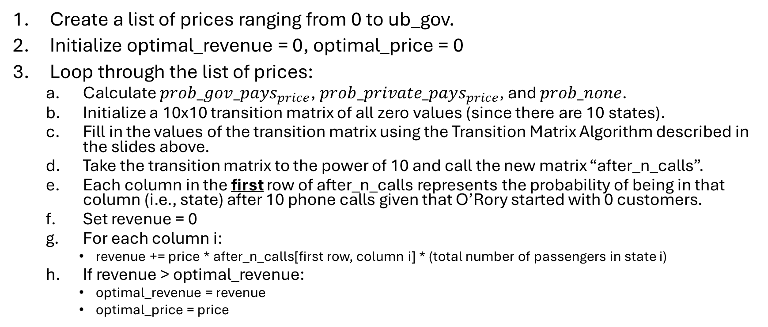
The Developed Model - Algorithm
Create a list of prices ranging from 0 to ub_gov.
Initialize optimal_revenue = 0, optimal_price = 0
Loop through the list of prices:
Calculate $prob_gov_pays_{price}$, $prob_private_pays_{price}$, and $prob_none$.
Initialize a 10x10 transition matrix of all zero values (since there are 10 states).
Fill in the values of the transition matrix using the Transition Matrix Algorithm described in the slides above.
Take the transition matrix to the power of 10 and call the new matrix “after_n_calls”.
Each column in the first row of after_n_calls represents the probability of being in that column (i.e., state) after 10 phone calls given that O’Rory started with 0 customers.
Set revenue = 0
For each column i:
revenue += price * after_n_calls[first row, column i] * (total number of passengers in state i)
If revenue > optimal_revenue:
optimal_revenue = revenue
optimal_price = price

Slide 12
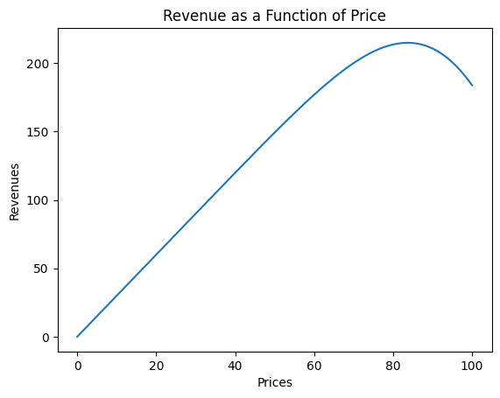
The Base Solution
The optimal price is $84 which yields an expected revenue of $214.96 per flight.

Slide 13
Sensitivity Analysis
What happens if the number of calls change?
Number of calls increase: revenue increases because the number of times a transition can be made increases, which increases the overall likelihood of a customer (either government or private) accepting a price.
Number of calls decrease: revenue decreases because the number of times a transition can be made decreases, which decreases the overall likelihood of a customer (either government or private) accepting a price.

Slide 14
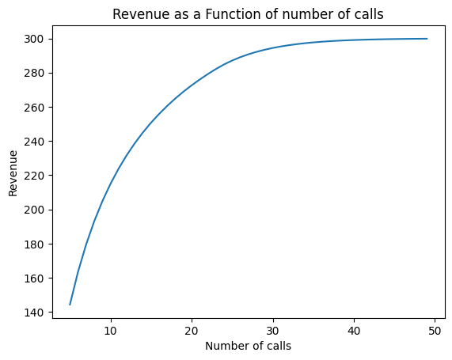
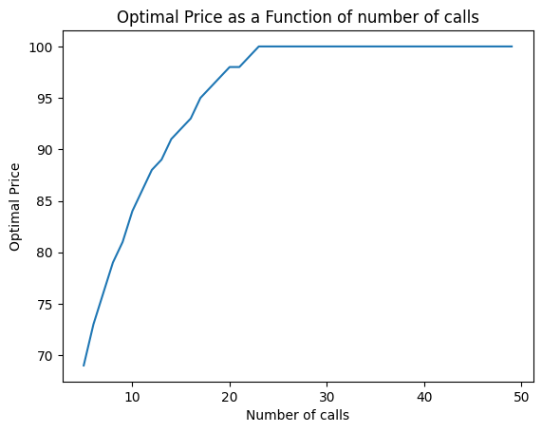
Sensitivity Analysis (Continued)
Revenue seems to have an asymptote of $300 and the optimal price becomes the maximum possible price of $100 after around 24 calls. This will be explained on the next slide.

Slide 15
Sensitivity Analysis (Continued)
As the number of calls increases, the probability of only being in recurring states (i.e., number of passengers is 3) gets extremely close to 1. This increases the revenue because the maximum number of passengers are paying per flight.
Additionally, as more calls are being made, the probability that customers will accept the highest price possible of $100 increases. Therefore, it’s worthwhile to set this high price because there will be enough people (all you need is 3) who will accept this price.
This explains why there is an asymptote for revenue of $300. It’s because (maximum 3 passengers) * (maximum $100 price) = $300

Slide 16
Conclusion
This case study shows how Markov Chains can effectively model dynamic pricing decisions under uncertainty. By structuring customer arrivals and acceptance probabilities as a transition matrix, we formulated an optimization model to maximize expected revenue per flight while accounting for limited seating capacity (3 seats) and the two customer categories (publicly funded and private clients).
Using the formulated optimization model, we determined that the optimal price is $84, yielding an expected revenue of $214.96 per flight. Sensitivity analysis showed that as the number of calls increases, revenue approaches an asymptote of $300, where the maximum price of $100 becomes viable due to a higher likelihood of customers accepting it.

